Slide 1
Evaluation of sea ice segmentation with manually validated images
Daniel Watkins
March 2025

Slide 2
Goals
Evaluate measures of segmentation quality for use in the context of ice floe identification
Introduce dataset with randomly sampled scenes from the pan-Arctic MIZ
Dataset to be published on Zenodo and/or Brown Digital Repository
Article to be published in IEEE Transactions on Geoscience and Remote Sensing
Dataset and measures to be used in calibration and validation paper

Slide 3
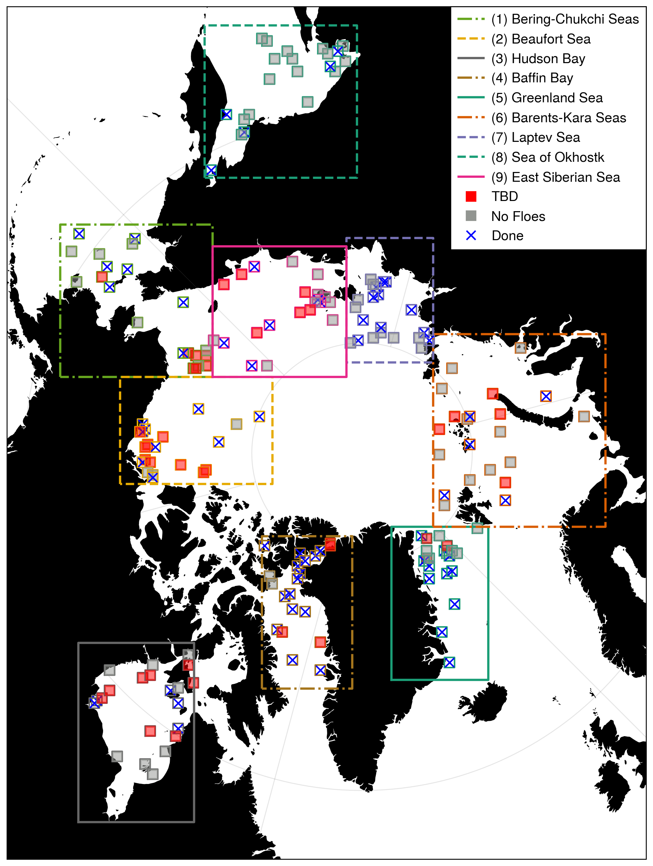
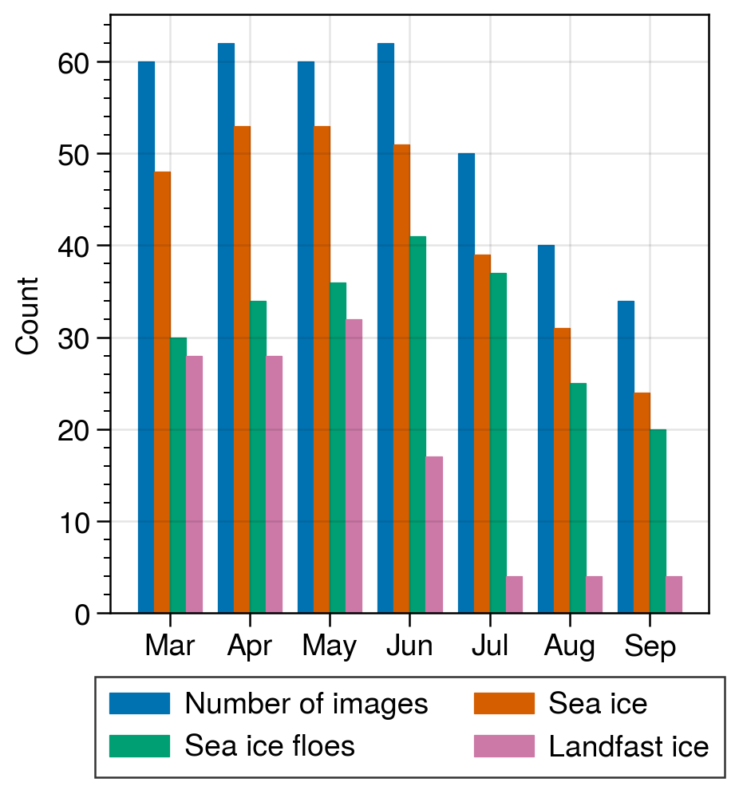
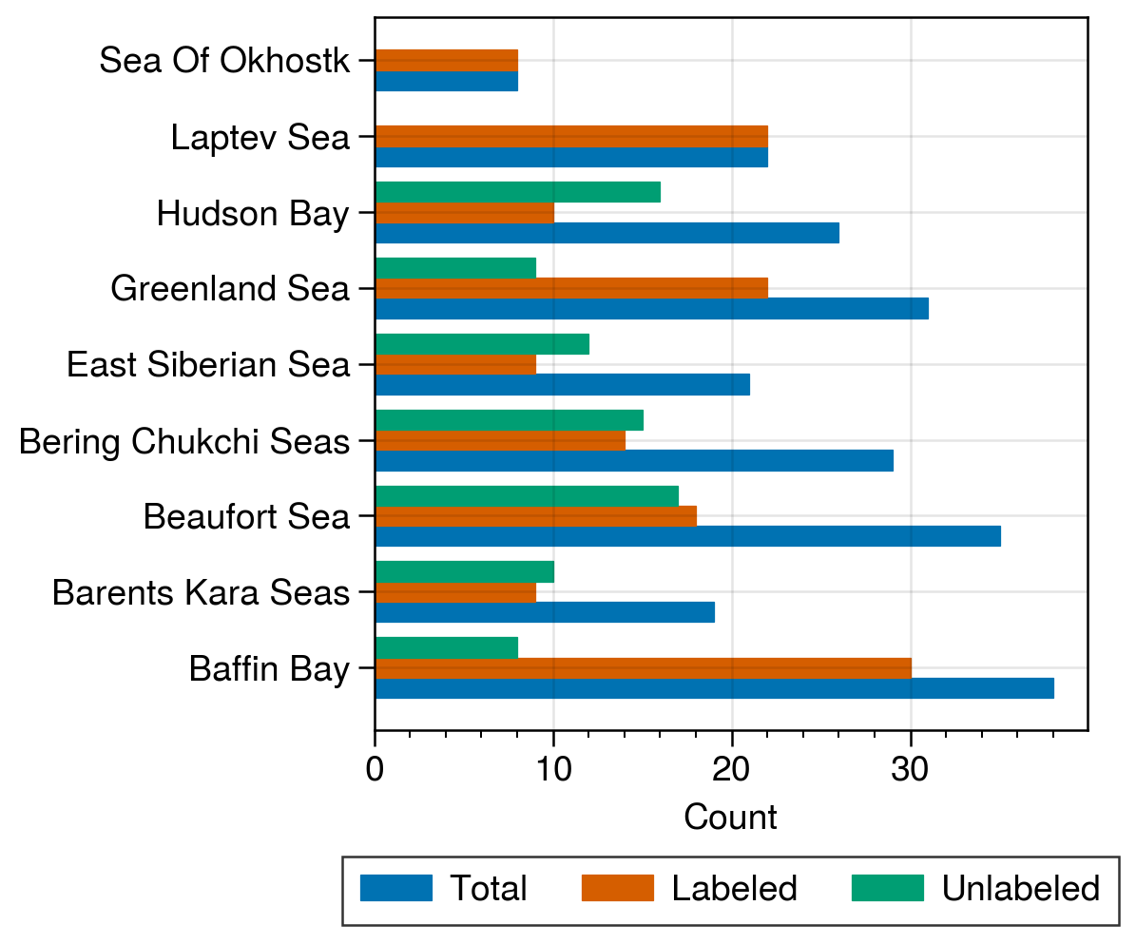
Preparation of the validation dataset
Iterative random sampling process
Stratified sample over time period with sea ice, years 2006-2023
Center point selected from NSIDC Climate Data Record pixels with sea ice between 15-85%
MASIE used to verify sea ice area fraction – if 0, new sample is drawn
100 km by 100 km MODIS images from both Aqua and Terra
378 images in total
2 satellites X 7 months X 3 samples per month
Sample metadata
Est. and calculated cloud fraction
(Y/N) sea ice, sea ice floes, landfast ice
Time stamp from SOIT
Binary manual labeling of ice floes, landfast ice, landmask
Photoshop files saved to enable inspection and simple edits
Semi-automated floe pairing
Overlap pairs w/ visual confirmation
Optical flow method with manual verification for clear sky cases with stronger drift
Top: Simple statistics from image metadata showing plausible seasonality. Middle: Progress toward labeling images with floes. Right: Progress toward manual floe labeling. Red boxes show remaining cases needing labeling.

Slide 4

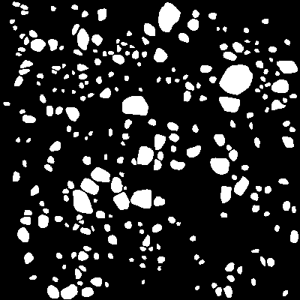


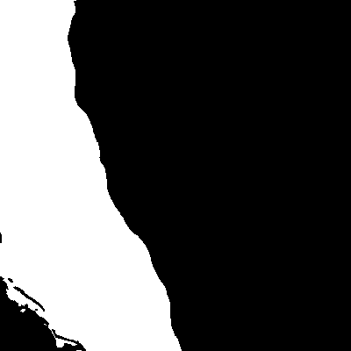
Validation dataset contents
truecolor
falsecolor
cloudfraction
landmask
floe mask
landfast
Case 166
Laptev Sea
Case 056
Beaufort Sea
True color, false color, landmask, and 5 km resolution cloud fraction saved for each case
Cloud fraction is a different resolution, but is arranged on the same snapshot data used for the true/false color data
Binary land, floe, and fast ice masks created for all the images where the metadata analysis says ice floes are present
Blank PNG files for cases with no land or landfast ice, for ease of use when compositing the masks for visualization
MASIE images (ice, land) accessed, reprojected, and interpolated to MODIS grid (not shown)

Slide 5
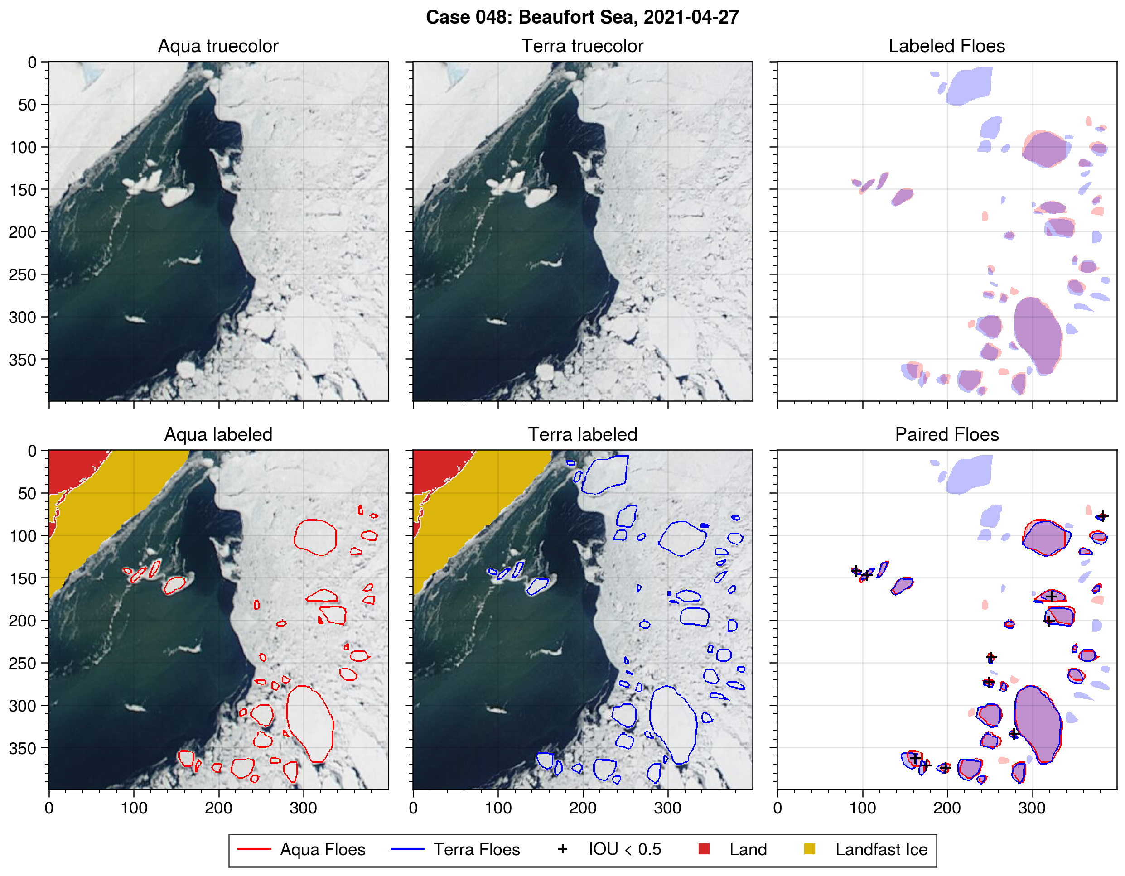
Floe pairing
Motivation
Assuming the true shape did not meaningfully change over the course of a few hours, linking floes from one image to the next lets us examine the uncertainty in floe shape property measurements even with best-case edge detection.
The paired floes can be used in the cal-val paper to test the IFT tracking capability.
Method
Check displacement between pairs of images
If displacement is small relative to the floe size, match based on overlapping floes.
For clear scenes with coherent motion, where floes do not overlap, use optical flow to estimate vector field. If advected flow shapes align well and are not distorted, consider these to be matches.
Store comparison image for verification.
Example images with overlaid floe (outlines), land (red), and landfast ice (yellow) masks. Labeled floes overlaid in top right show relatively little motion between images. Outlines show floes with potential matches. Black markers show those with intersection over union less than 50%, where manual review is needed.

Slide 6
Measuring of segmentation quality
Supervised evaluation
Segmentation results S compared against ground truth G
Pixel-by-pixel comparison
Object-based comparison
“Relevant set:” for each g in G, set of objects in S fulfilling some criteria
Clinton et al. 2010 criteria: 50% area overlap (either direction) and/or centroid inclusion (either direction).
Unsupervised evaluation
Segmentation results evaluated against properties of the image
Contrast, entropy
1
2
G
S
Object 1 relevant set
Object 2 relevant set

Slide 7
Experiment #1: Random pairing
Baseline
Variation between paired floes
Flow shape registration: rigid rotation and transposition (compare to alignment via centroid and rotation by the estimated object axes orientation)
Experiment
Randomly select non-paired floe
Align by centroid and object orientation
Measure difference between floes
Analysis
For a measure M and paired floes f, g, is M(f, g) statistically significant?
Consider grouping floes by area bins

Slide 8
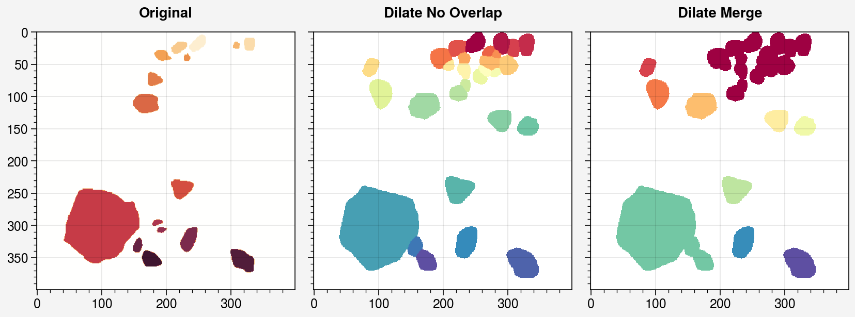
Experiment #2: Introducing known error
Testing sensitivity to specific types of interpretable errors
Experiments
Increasing floe area without merging
Increasing floe area with merging (undersegmentation)
Decreasing area by dilation
Decreasing area by splitting objects (oversegmentation)
Translation
Missing floes (uniform, small only, large only)
Analysis
Correlation between measures
Which are redundant?
Sensitivity:
How large do changes need to be to register change?
Error sensitivity by floe size?

